Slide 1
Understanding Classes
& Array

Slide 2
Quick List
Recap
Classes
1. objects,
2. properties,
3. methods,
4. creating classes
Arrays

Slide 3
What is a class?
Class in the OOP is called a definition (specification) of a given type of objects from the real-world. It represents a pattern, which describes the different states and behavior of the certain objects (the copies), which are created from this class (pattern).
Object is a copy created from the definition (specification) of a given class, also called an instance

Slide 4
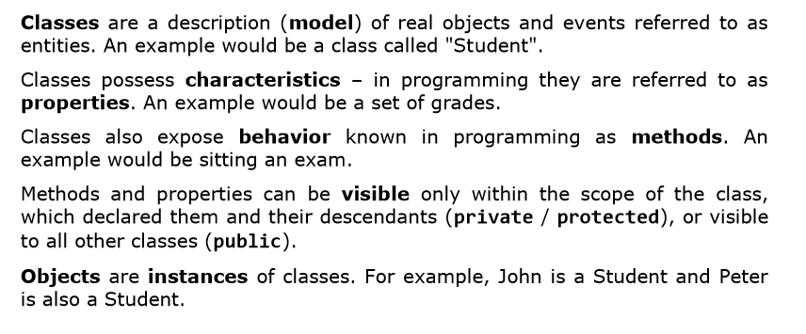
What Does a Class Contain?

Slide 5
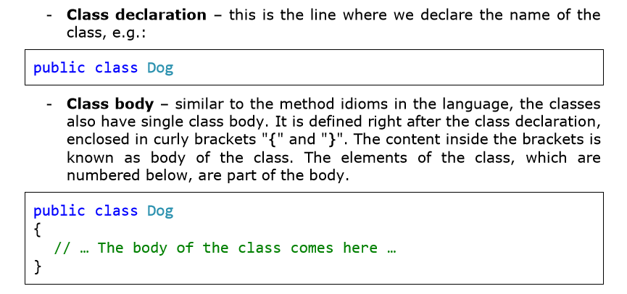
Elements of the Class

Slide 6
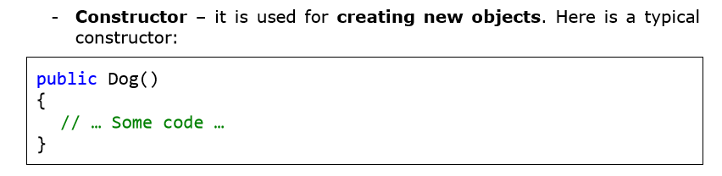
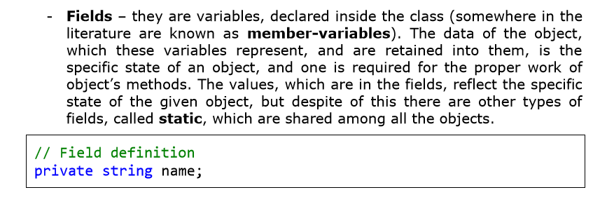

Slide 7
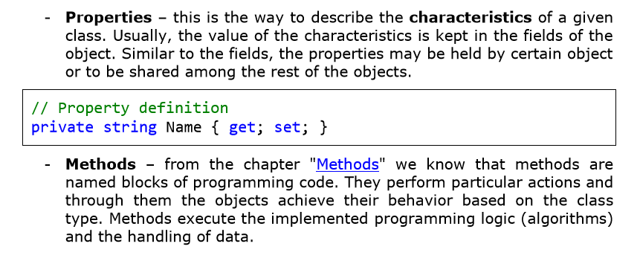

Slide 8
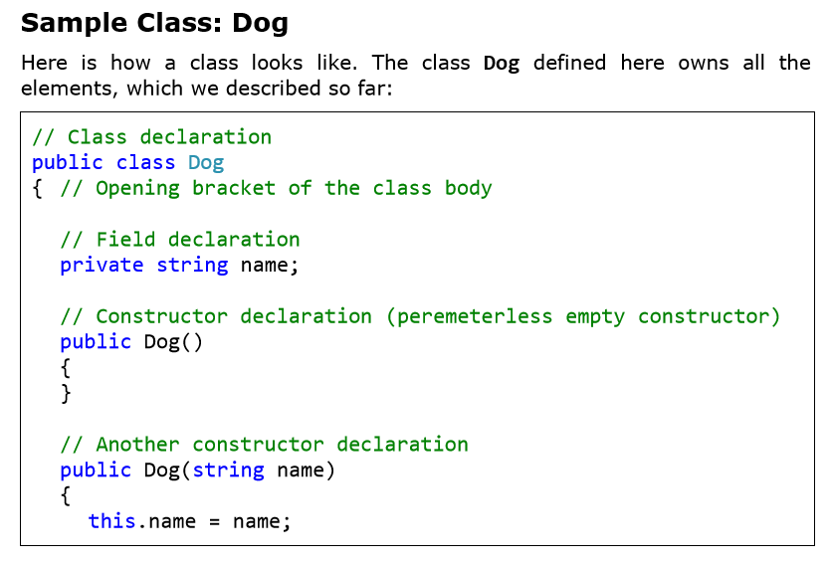

Slide 9
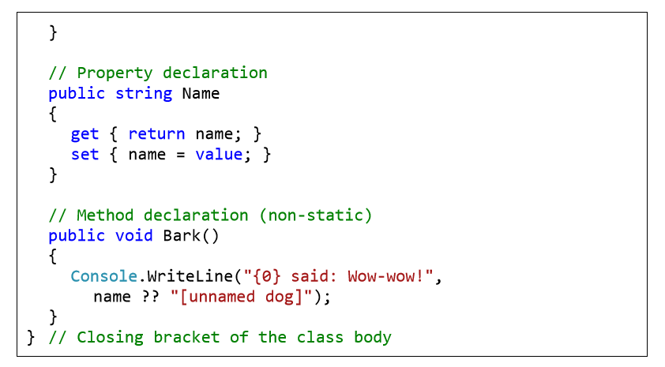

Slide 10
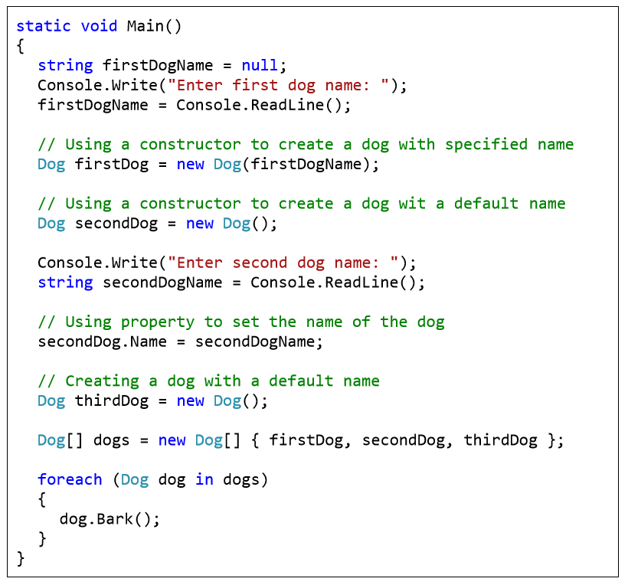
Example – A Dog Meeting

Slide 11
Show the output from the execution of the code above:

Slide 12
Arrays

Slide 13
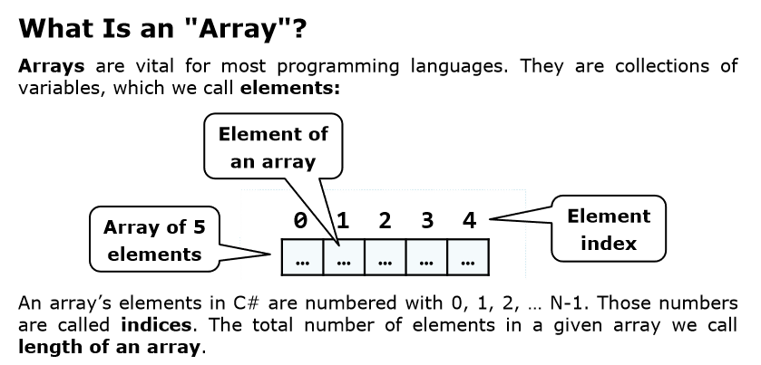

Slide 14
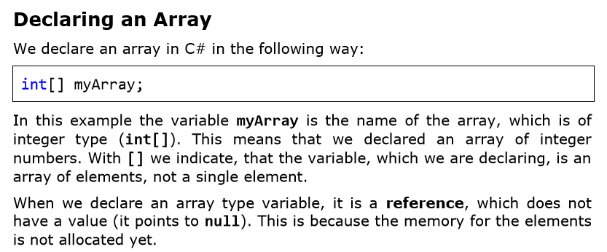

Slide 15
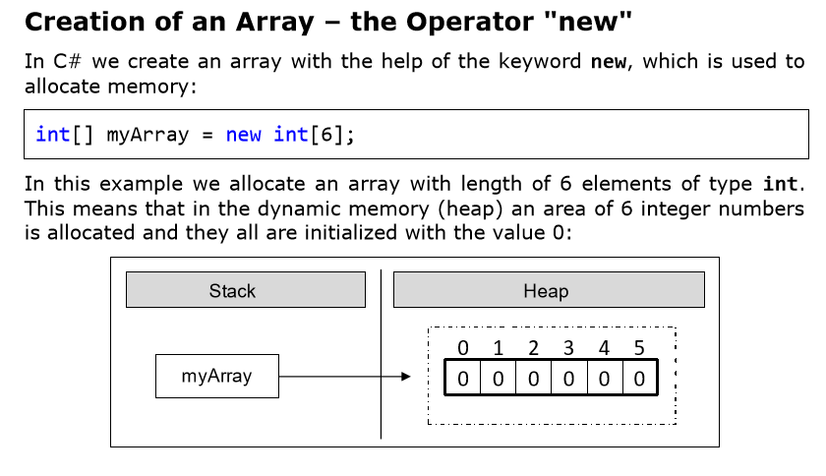

Slide 16
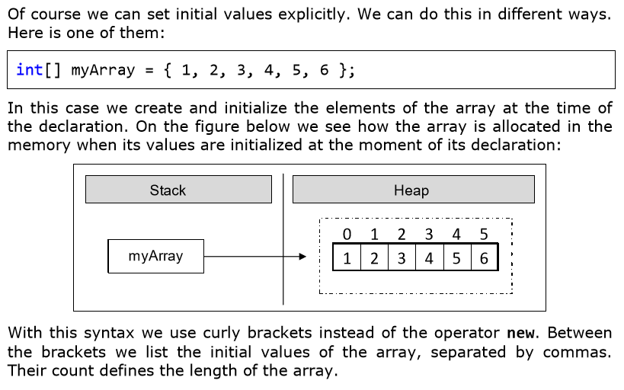
Array Initialization and Default Values

Slide 17
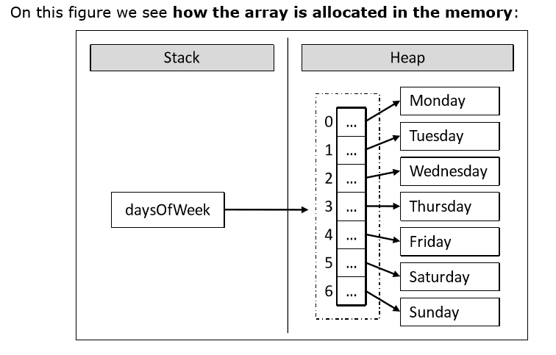
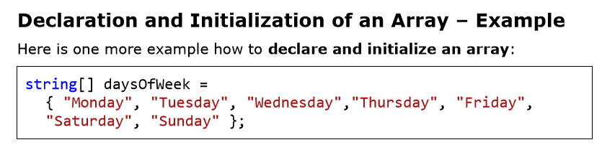

Slide 18
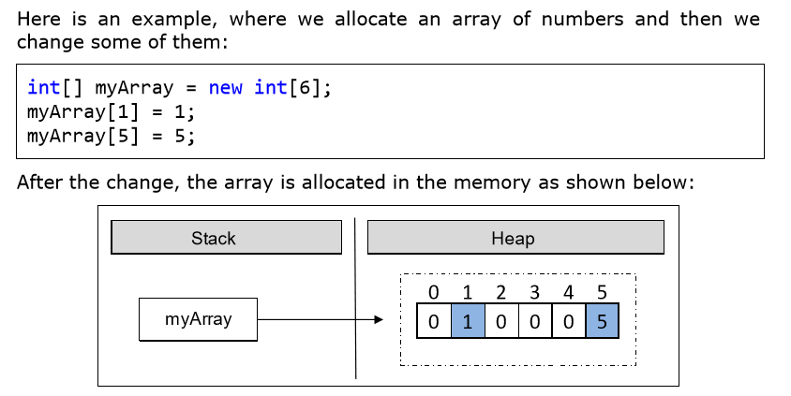

Slide 19
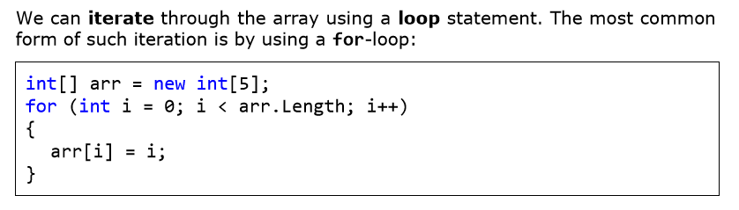
Iterating through array using a Loop

Slide 20
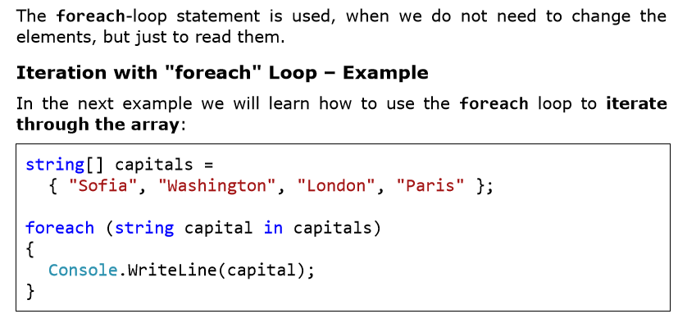
Foreach Loop

Slide 21
The End
Ooko Emmanuel

